Slide 1
UNC Chapel Hill School of Social Work Clinical Institute
The Relevance of DBT to Trauma Work
DAY 2
Two-Day Training with
Deborah Barrett, PhD, LCSW
&
Robin Sansing, MSW, LCSW

Slide 2
Day 2 Agenda
9:00 Welcome & Mindfulness
9:10 I. Case conceptualization
10:15 BREAK
10:30 II. Q & A and case consultation
12:00 LUNCH
1:00 III. DBT skills
2:30 Break
2:45 IV. DBT Skills
4:00 V. Summation, discussion, resources
4:30 END

Slide 3
Mindfulness
Nonjudgmental Stance

Slide 4
Questions from yesterday?

Slide 5
I. Case conceptualization
(case formulation)

Slide 6
Elements of Case Formulation
Demographic history & thorough symptom assessment
Primary targets – according to stage of treatment
Secondary targets
Assessment of skills and skills deficits
Uncovering “controlling variables”
Case conceptualization should be
revised regularly

Slide 7
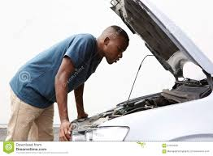
dialectical dilemmas
Secondary targets
Emotional vulnerability
Unrelenting crisis
Active passivity
Apparent competence
Inhibited grief
Self-invalidation
Notes:
Dilectical dilemmas
Emotional vulnerability and self-invalidation – modulation of emotion (over and undercontrol)
Apparent competence/ active passivity – about how to communicate experience/ ask for help -- metaphor of shipwrecked woman coping, and rescue plane is flying overhead (how to present?)
Crisies/grief – processing losses, trauma – pattern of impulsivity and poor judgment, chaos, related to incapacity to tolerate and process trauma vs. avoidance

Slide 8

Adolescent secondary targets
Excessive leniency
Normalizing pathological behavior
Forcing autonomy
Fostering dependence
Pathologizing normative behavior
Authoritarian control

Slide 9
Case formulation
Based on repeated BCAs and in-session observations
Identify controlling variables and typical patterns that set off, lead to or maintain the problem behavior. Include operating hypotheses – “What’s getting in way?”
  EXAMPLES: secondary targets, skill deficits, invalidation, problematic cognition, contingency/reinforcement patterns →“controlling variables”
Opportunity to see what you don’t yet know
Formal case formulation and “mini-case-formulations” (do often, include date)
*Guides your treatment plan . . .

Slide 10
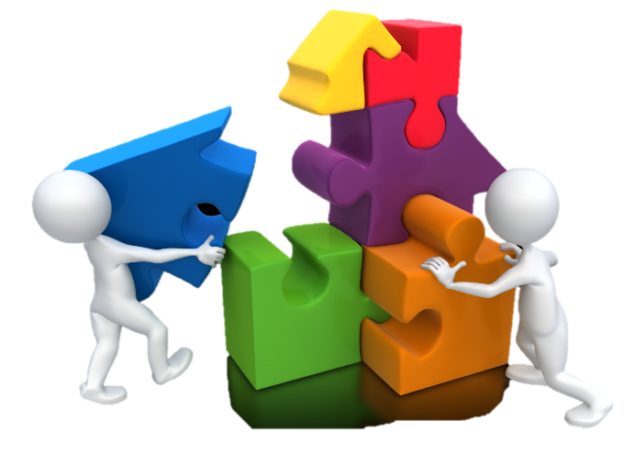
Samantha
developing a
Case Formulation

Slide 11
Conceptualization comes through finding common links through repeated chains

Slide 12
Samantha – BCA of NSSIB
Cutting forearm
Vulnerabilities
Tired,
food deficit, invalidated by mother
Consequences:
Felt relief
Exhaustion
Didn’t want to wake up
Triggering event
Friend left
Links:
“I’m all alone”
“My friend might die”
Scared, sad, hopeless
Noticed urge to cut
Stared at razor
Couldn’t think of alternative
“Fuck it”
Skills?
Relationship with emotions?
Contingencies & reinforcement?

Slide 13
Samantha – BCA (therapy interfering behavior)
Called to quit therapy
Consequences:
Felt relief about giving up
Later therapist helped me calm down
Vulnerabilities
Hurting,
Tired
Triggering event
Spoke about car accident in therapy
Links:
“I don’t want to be doing this”
Felt raw, exposed, guilt, shame, self-disgust
Held it together until end of session
Trouble breathing
“I can’t stand it”
Stepped into traffice
Skills?
Relationship with emotions?
Contingencies & reinforcement?

Slide 14
Case formulation: Samantha
Factors that control targeted problem:
  Skill deficit? Teach relevant skill.
  2. What else is getting in the way?
    Secondary targets:
Mindfulness | Distress tolerance
Emotion Regulation | Interpersonal effectiveness
Active passivity Emotion reactivity Unrelenting crisis | Apparent competence Self-invalidation Inhibited grieving
Notes:
urge surfing, distress tolerance (e.g., TIP)

Slide 15
Your Turn
In Pairs:
Fill out your own case conceptualization
  Select a current (or past) client of yours

Slide 16
II. Q & A
Case conceptualization?
Linking to treatment planning?
DBT treatment in general?
Case consultation?

Slide 17
III. DBT Skills
Core Mindfulness & Interpersonal Effectives

Slide 18
Core Mindfulness

Slide 19
Goals of module:
  To learn to observe one’s thoughts, feelings, and sensations without reacting to them
  To increase control of one’s experience
  To cultivate a non-judgmental stance
  To participate in life with awareness (rather than impulsive or mood-dependent behaviors)
  To experience reality as it is

Slide 20
Core Mindfulness – States of mind
Awareness of each “mind state”
sensation = sensation
Reason
Mind
Emotion
Mind
Cultivate “Wise Mind”
Wise
Mind
Balanced point of view
intersection of reason and emotion states
Embraces dialectic
sensation = sensation
Body
Mind
Notes:
Mindfulness of sensation
Curiosity about experience
Bring information from other mind states to locate wise mind

Slide 21
Core Mindfulness – What and How Skills
What to do:
Observe
Describe
Participate
How:
Nonjudgmentally
One-mindfully
Effectively

Slide 22
Interpersonal Effectiveness

Slide 23
Interpersonal Effectiveness
→What is the goal of the communication?
Objective Effectiveness
What is my objective – What do I need to get out of this interaction?
Relationship Effectiveness
How do I want the other person to feel about me after our interaction?
Self-respect Effectiveness
How do I want to feel about myself after our interaction?
*Walk the Middle Path
– Maintaining balance in relationships*

Slide 24
Objective Effectiveness
How
DEAR
  Describe the current situation
  Express feelings and opinions
  Assert or by asking or saying no
  Reinforce
(WO)MAN
  Wise mind place
  One mindfully
  Mindful of objectives
  Appear confident
  Negotiate alternative solutions
What

Slide 25

Relationship Effectiveness
  Gentle manner
  Interested in the other person
  Validate the other person without judging
  Easy manner with humor

Slide 26

Self-respect Effectiveness
FAST
  be Fair
  no Apologies
  Stick to values
  be Truthful

Slide 27
In pairs:
Practice your DEAR (WO)MAN
Your turn

Slide 28
IV. DBT Skills
Emotion Regulation & Distress Tolerance

Slide 29
Emotion Regulation

Slide 30
Emotion Regulation Skills
Understanding & Naming Emotions
Changing Unwanted Emotions
Reducing Vulnerability to Emotion Mind
Managing Extreme Emotions

Slide 31
Emotion Regulation
Start with → All emotions are VALID
* May or may not be justified/warranted
Practice NAMING emotions

Slide 32
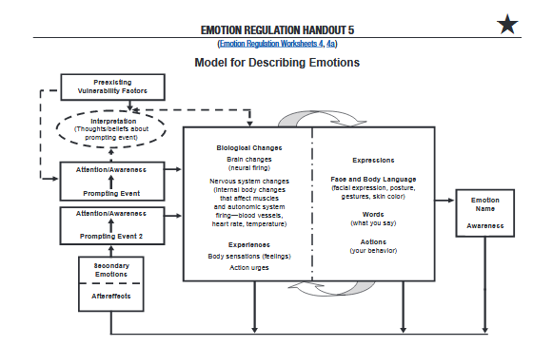
Components of Emotions

Slide 33
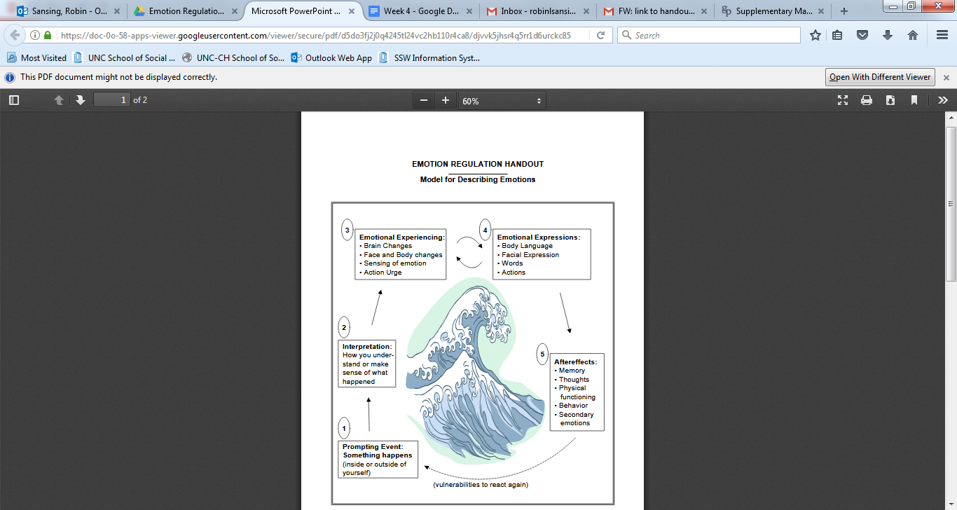
Components of Emotions or “the Wave
Seth Axelrod

Slide 34
Changing unwanted emotions
→ Opposite Action
FEAR ………………
ANGER ……………
ENVY ………………
LOVE ………………
SADNESS ………….
SHAME/GUILT ……
Approach
Gently avoid/Be kind
Gratitude
Avoid/Distract
Get active/Avoid avoiding
Make public/Repeat

Slide 35
Distress Tolerance

Slide 36
The ability to tolerate and survive crises without making things worse

Slide 37
Holding an Open Heart Towards What Is.
Pain+ Non-acceptance =
Suffering & Being Stuck
Pain + Acceptance =
Ordinary Pain & the Possibility of Moving Forward

Slide 38

Distress Tolerance Skills
Crisis Survival Skills
Reality Acceptance Skills
Skills when the crisis is addiction

Slide 39

Crisis survival skills with Distraction
Wise Mind ACCEPTS
  Activities
  Contribute
  Comparisons
  Change your Emotions
  Push away thoughts
  Think of other things
  Sensations
IMPROVE the moment with cognitive techniques:
  Imagery
  Meaning
  Prayer
  Relaxation
  One-thing-in-the-moment
  Vacation
  Encouragement

Slide 40






Distress Tolerance Skills:
Self soothe (with five senses)
Notes:
Experiential exercise: self-soothe kit

Slide 41
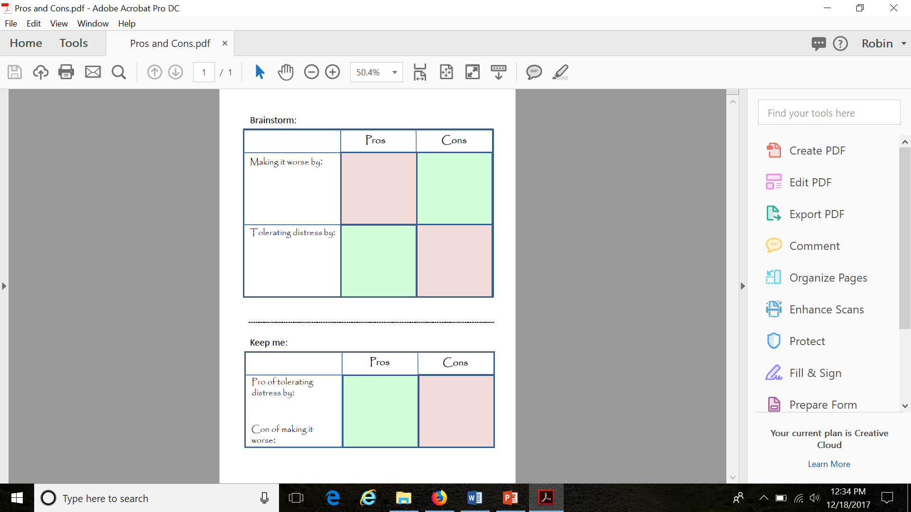
Crisis survival with
Pros & Cons

Slide 42

Reality Acceptance skills:
- Radical Acceptance
- Willingness
- Turning the mind

Slide 43

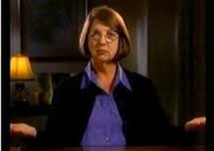


Distress Tolerance: Willingness practices
Willing hands, posture
Small smile
Willingness is saying yes to the mystery of being alive in each moment. Willfulness is saying no, or perhaps more commonly, “yes, but . . . ”
Source: Gerald May, 1982, in Care of Mind-Care of Spirit: Psychiatric Dimensions of Spiritual Direction, San Francisco: Harper and Row, p.6.

Slide 44
Skills Modules:
Q & A

Slide 45
Summary

Slide 46
DBT Review
Components of treatment
Individual therapy
Skills group (CM, IPE, ER, DT)
Phone skills coaching
Consult team
Ways to approach any problem
Solve the problem
Change your perception of the problem
Radically accept the problem
Stay miserable
Session structure:
Review Diary Card
Attention to target hierarchy
Chain Analysis on highest target
Weave in Solution Analysis
Move down hierarchy → current life situations
Primary Targets (hierarchy -levels)
Life-threatening behaviors (SI, NSSI)
Therapy-interfering behaviors (TIB)
Quality of life behaviors (QL)
Skills acquisition
Stages of therapy:
IV. Incompleteness → Capacity for sustained joy
III. Problems in living → Ordinary happiness & unhappiness
II. Quiet desperation → Emotional experiencing
I. Severe Behavioral Dysregulation → Control

Slide 47
DBT Review (cont.)
Secondary targets (dialectical dilemmas):
Therapist characteristics
Emotional vulnerability
Oriented to change
Unwavering centeredness
Unrelenting crisis
Active passivity
Benevolent demanding
Compassionate flexibility
Apparent competence
Inhibited grief
Nurturing
Oriented to acceptance
Self-invalidation
Dialectical approach:
Acceptance (validation) & Change (problem solving)
Synthesis (and/both)
Transactional (person & environment)

Slide 48
DBT Review (cont.)
Assumptions about patients
People are doing the best they can.
People want to improve
People must learn new behaviors both in therapy and in the context of day-to-day life.
People cannot fail in DBT
People may not have caused all of their problems, but they have to solve them anyway.
People need to do better, try harder and be more motivated to change.
The lives of people who are suicidal are unbearable as they are currently being lived.
Assumptions about therapists
The most caring thing a therapist or treatment provider can do is help people change in ways that bring them closer to their own ultimate goals.
Clarity, precision and compassion are of the utmost importance.
The treatment relationship is a real relationship between equals.
Principles of behavior are universal, affecting clinicians no less than clients.
Treatment providers need support
Treatment providers can fail.

Slide 49
DBT Review (cont)
Core Strategies = Validation + Problem Solving
Behaviors to Decrease
Interpersonal chaos
Labile emotions and moods
Impulsiveness
Confusion about self and cognitive dysregulation
Quality-of-life interfering behaviors
Skills / behaviors to increase:
Core mindfulness
Interpersonal effectiveness
Emotion regulation
Distress tolerance
Self-management and life skills
Dialectical Strategies:
Entering the paradox
Metaphor
Devil’s advocate
Extending
Change Strategies:
Contingency management
Skills
Exposure
Cognitive Modification
Activating Wise Mind
Making lemonade
Allowing natural change
Dialectical assessment

Slide 50
Core Strategies = Validation + Problem Solving
Levels of Validation:
Being Present
Accurate Reflection
Reading Cues
History
Normalizing
Radical genuineness
Validation Strategies
Emotional validation
Behavioral validation
Cognitive validation
Cheerleading
https://www.youtube.com/watch?v=-4EDhdAHrOg

Slide 51
Core Mindfulness
“How” skills
  One-mindfully
  Non-judgmentally
  Effectively
Loving kindness
States of Mind
“What” skills
  Observe
  Describe
  Participate

Slide 52

Emotion Regulation
Mindfulness of current emotion
Understanding & naming emotions
Emotion myths
Describing emotions
Check the facts
Problem solving
Opposite action
ABC PLEASE
Identifying skills breakdown

Slide 53
Distress Tolerance
STOP
Pros & Cons
TIP
Wise mind ACCEPTS
Self-soothe
Body scan
IMPROVE the moment
Radical Acceptance
Half smile & willing hands
Turning the mind/Mindfulness of current thoughts

Slide 54
Interpersonal Effectiveness
Factors reducing effectiveness: Myths & Cheerleading
Objective Effectiveness – DEAR (WO)MAN
Relationship Effectiveness – GIVE
Self-respect Effectiveness - FAST
Intensity of need (The dime game)

Slide 55
Using DBT with a variety of populations

Slide 56
Case explorations
What stage of treatment are they in?
Primary target behaviors?
Secondary targets?
Life worth living goals?
Acceptance, change, dialectical strategies?
Skill areas to target?
Consultation?

Slide 57
Resources
Articles on DBT & Trauma
Texts and websites
Local resources
Certification:

Slide 58
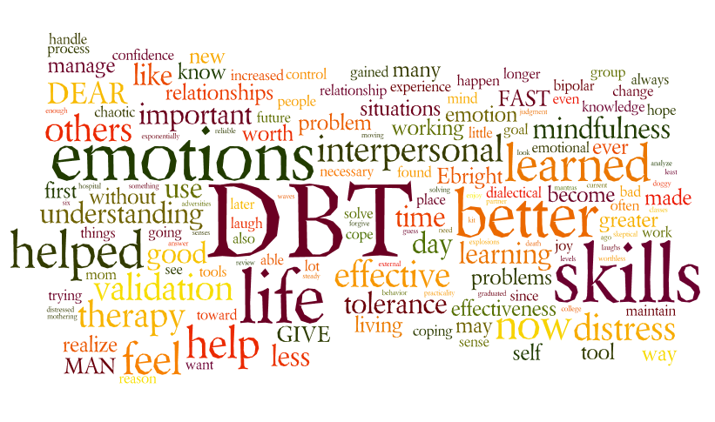
DBT Kahoot!

Slide 59

https://dbt-lbc.org/

Slide 60
Closing awareness
&
From Debbie & Robin
Thank you !

